Slide 1
Number Plate Detection
By,
Tarun Ashwini
M. A. Muneer
Thumar Jankiben Narshibhai
Informational Technology
IT Department

Slide 2
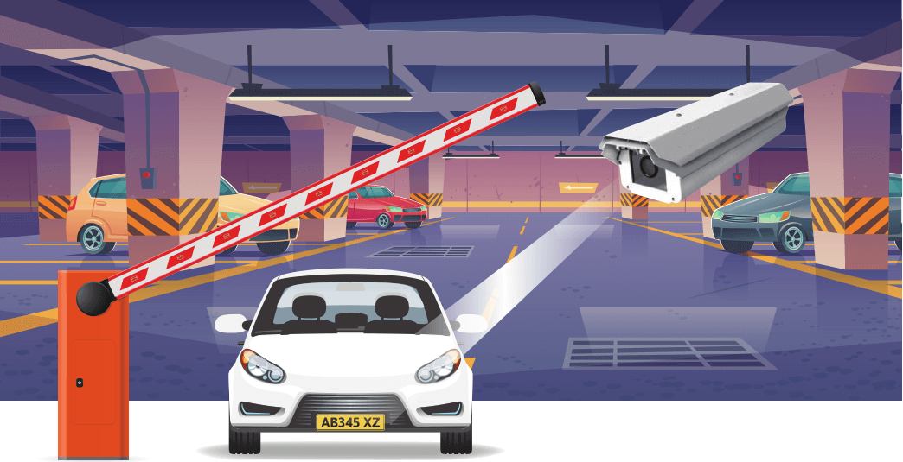
ABSTRACT
With the popularization of automobile and the progress of computer vision detection technology, intelligent number plate detection technology has gradually become an important part of intelligent traffic management. Number plate detection is used to segment vehicle image and obtain license plate area for follow-up recognition system to screen.
It is widely used in intelligent traffic management, vehicle video monitoring and other fields.
IT Department

Slide 3
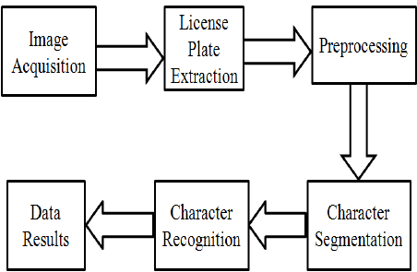
INTRODUCTION
Number Plate Recognition, the process undergoes into several steps and they are listed below:
From the full image, only the number plate is detected and processed. In character segmentation phase each and every character is isolated and segmented. Based on the selection of features of characters, each character is recognized, in the character recognition phase. and the result is outputted.
IT Department

Slide 4
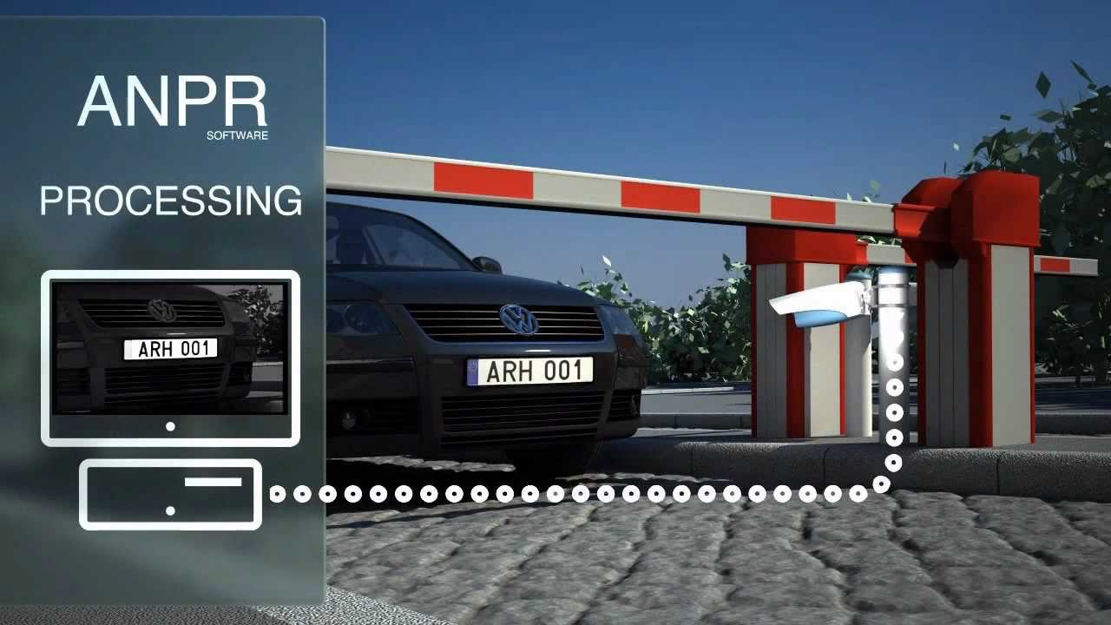
EXISTING SYSTEM
Automatic Number Plate Recognition (ANPR) system using Optical Character Recognition (OCR).
It is one of the good way of detecting the number plate.
In this system there are two major components and they are:
Cameras at front-end: It is responsible for capturing and sending the image to the Computers at Back-end.
Computers at Back-end: Now, the Back-end systems uses OCR for extracting the alphanumeric characters. For operating in big scale it needs of high end farm of systems.
IT Department

Slide 5
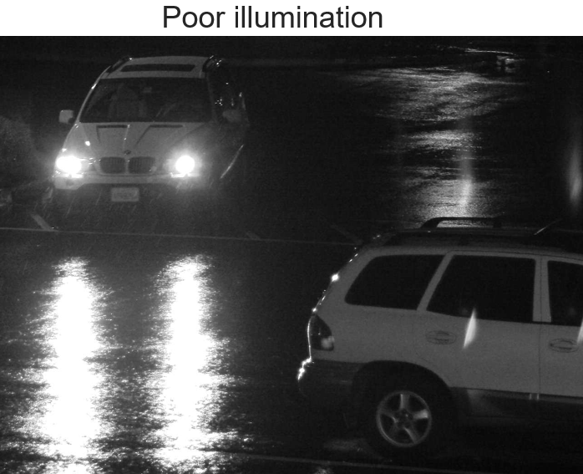
DRAWBACKS OF EXISTING SYSTEM
In recent years, this technology of license plate recognition is getting implemented at a fast pace. All these use-cases are implied in real-time environments replacing the human eye with computer vision. This raises problems such as
a) motion blurred effect due to fast-paced vehicle.
b) excessive light due to external headlights/reflections.
c) poor illumination due to night time or broken street lights.
d) plate contamination due to malfunctioning street/building lights.
e) low resolution due to dust/rain/hardware.
f) tilted image due to camera angle.
g) character contours like various font style/size.
h) segmentation level due to plate background/texture/natural light.
i) similar characters such as D-0-Q-U, 2-Z, S-5, B-8–3, and C-G.
IT Department

Slide 6
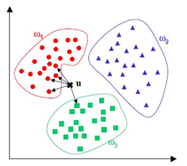
PROPOSED SYSTEM
We first introduce how to locate license plates and extract their corresponding regions, then segment these characters on located license plate.
And finally use “K-nearest neighbor (KNN) classifiers” to recognize these segmented characters.
IDEA:
The sensory experiences will be very different and much more challenging in real time. Due to a variety of factors, it will be highly challenging for the algorithm to accurately detect the values, and occasionally the photographs may be rejected or identified incorrectly.
In order to accurately and efficiently anticipate the characters, it is therefore intended to train the algorithm using a variety of samples using the kNN algorithm.
IT Department

Slide 7
Advantages of Proposed System
It may help classifying the things very fast.
It may produce high accuracy.
It is much more feasible and effective in classifying the elements in the segmentation phases.
IT Department

Slide 8
Software Requirements
Operating System: Windows 11.
Language: Python
Tool : VS Code
Modules Required:
Open Computer Vision
Sci-kit Learn
NumPy
IT Department

Slide 9
Hardware Requirements
System Type: 64-bit Operating System, I3 Processor.
Hard Disk: 5 GB.
RAM : 2 GB and more.
3 Mega pixel Camera
Monitor : 15 inch VGA Colour
Mouse : Hp Mouse
Keyboard : Standard Keyboard
IT Department

Slide 10
Functional Requirements
An Image with proper resolution should be sent as an input the system.
Model need to be trained on the character detection.
We need to train an algorithm with different characters of different styles.
The software should be able to detect the Characters on the Number Plate.
We need to check the accuracy of the detection.
IT Department

Slide 11
Non-Functional requirements
Reliability: The system is highly reliable.
Accessibilty: It can be easily accessible, that is click and run.
Efficiency: Resources consumption for given load is quite low.
Fault tolerance: Our system is fault tolerant due to insufficient hardware and Training.
Robustness: Our system is not capable to cope with errors during execution.
Scalability: Our project is scalable, that is we can add more resources to our project without disturbing the current scenario.
IT Department

Slide 12
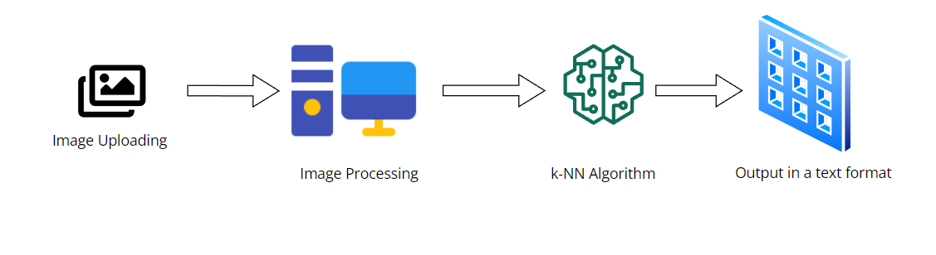
System Architecture
IT Department

Slide 13
UNIFIED MODELING LANGUAGE DIAGRAMS
IT Department

Slide 14
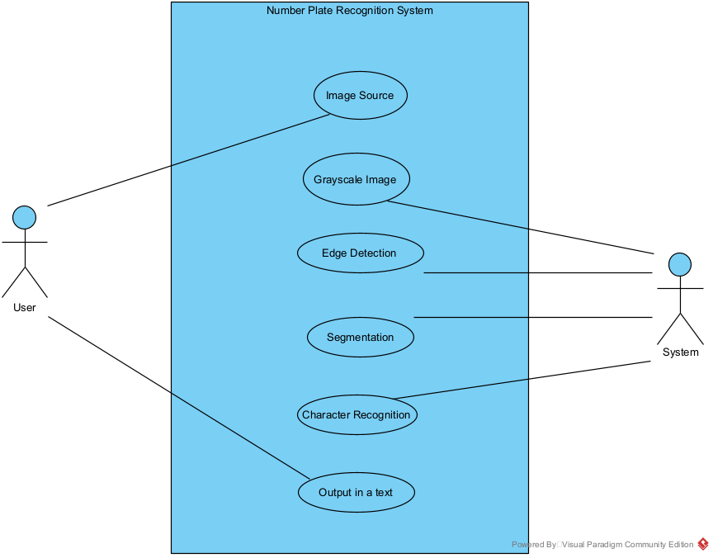
USE CASE DIAGRAM
IT Department

Slide 15
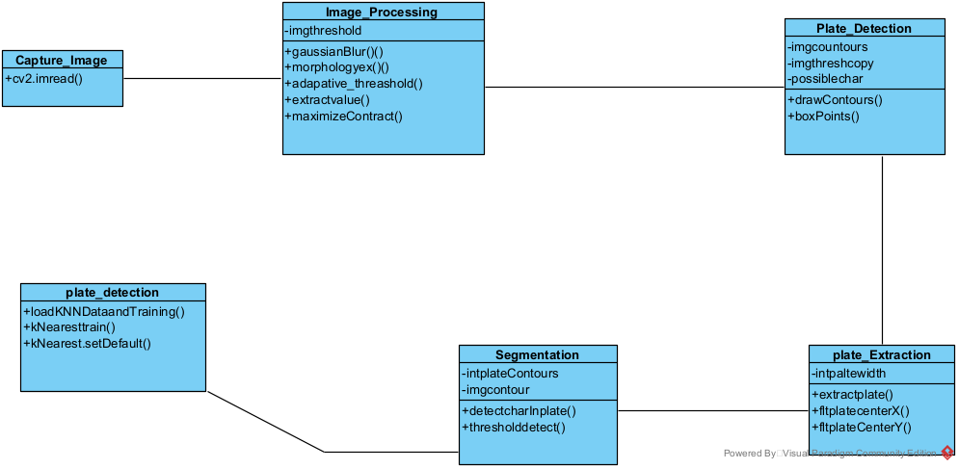
CLASS DIAGRAM
IT Department

Slide 16
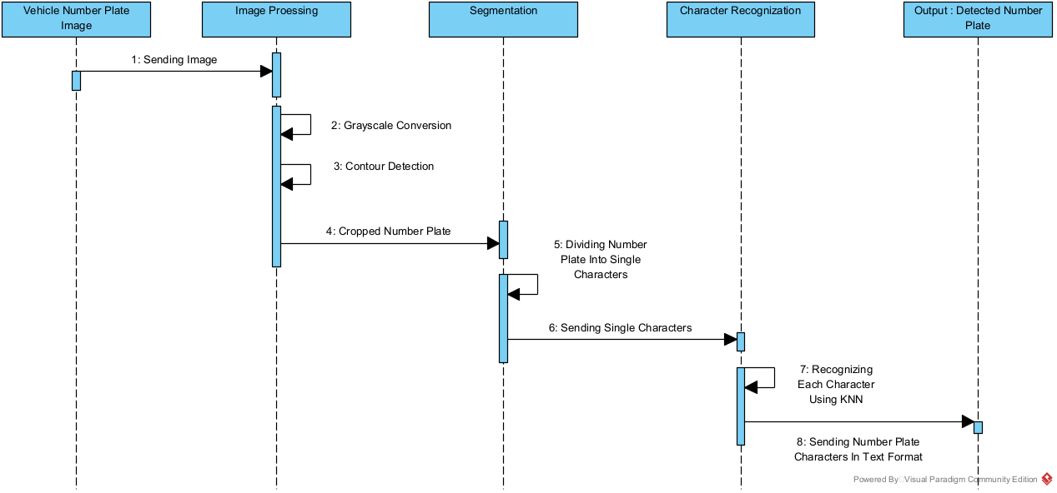
SEQUENCE DIAGRAM
IT Department

Slide 17
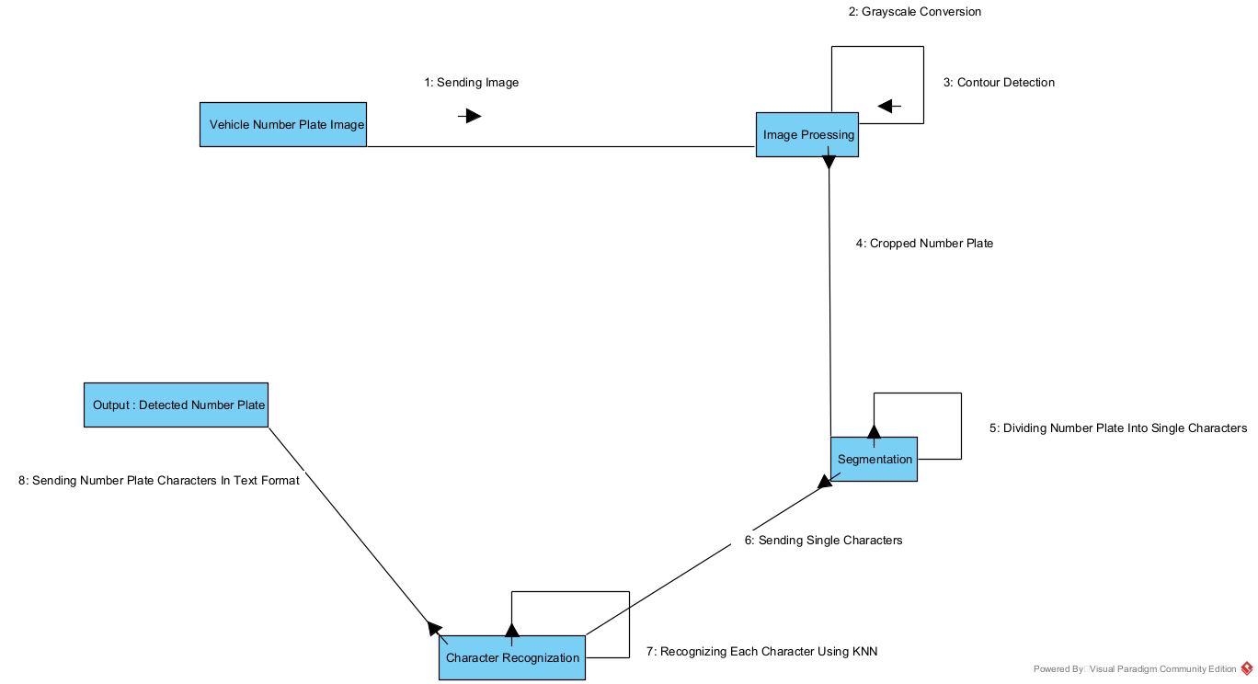
COLLABRATION DIAGRAM
IT Department

Slide 18
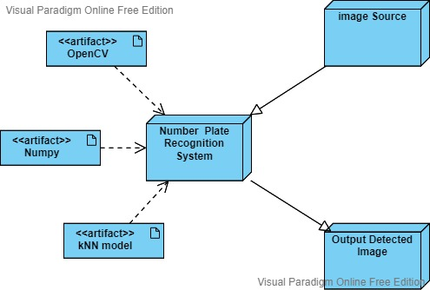
DEPLOYMENT DIAGRAM
IT Department

Slide 19
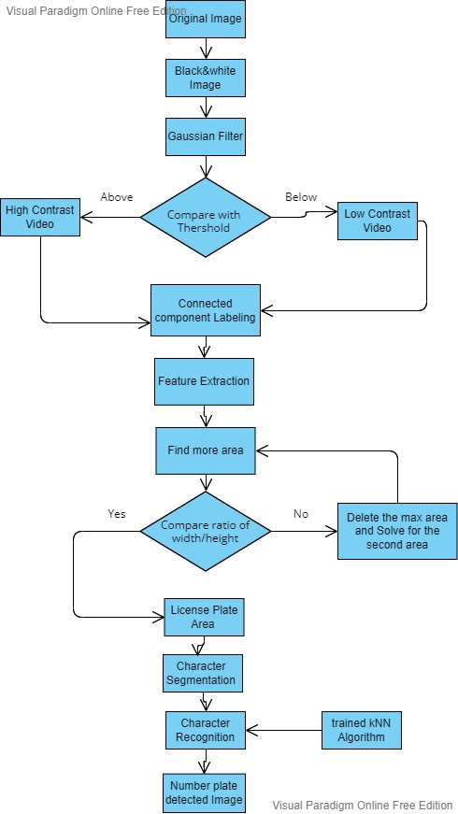
ACTIVITY DIAGRAM
IT Department

Slide 20
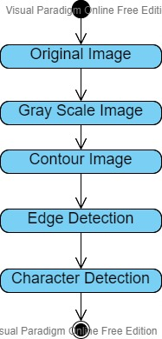
STATE CHART DIAGRAM
IT Department

Slide 21
Test Screen

Slide 22
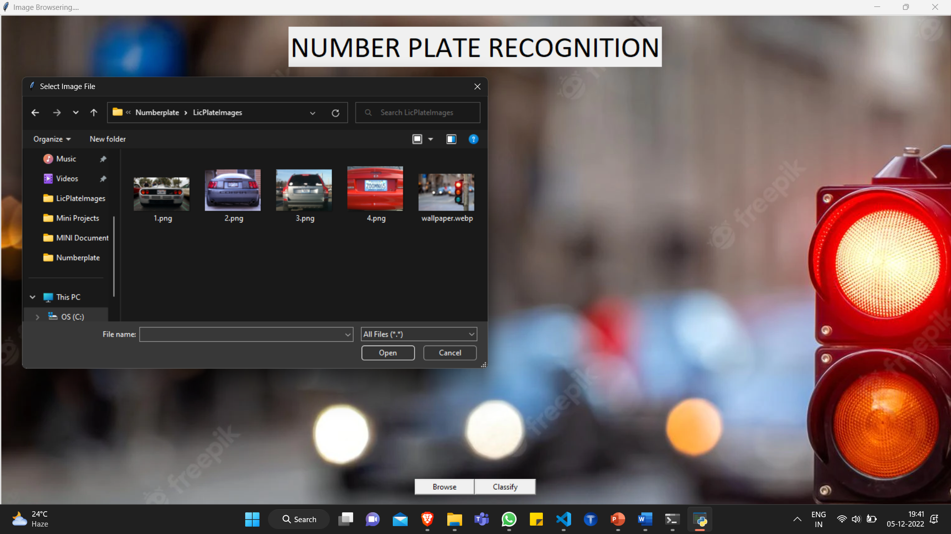
USER INTERFACE

Slide 23
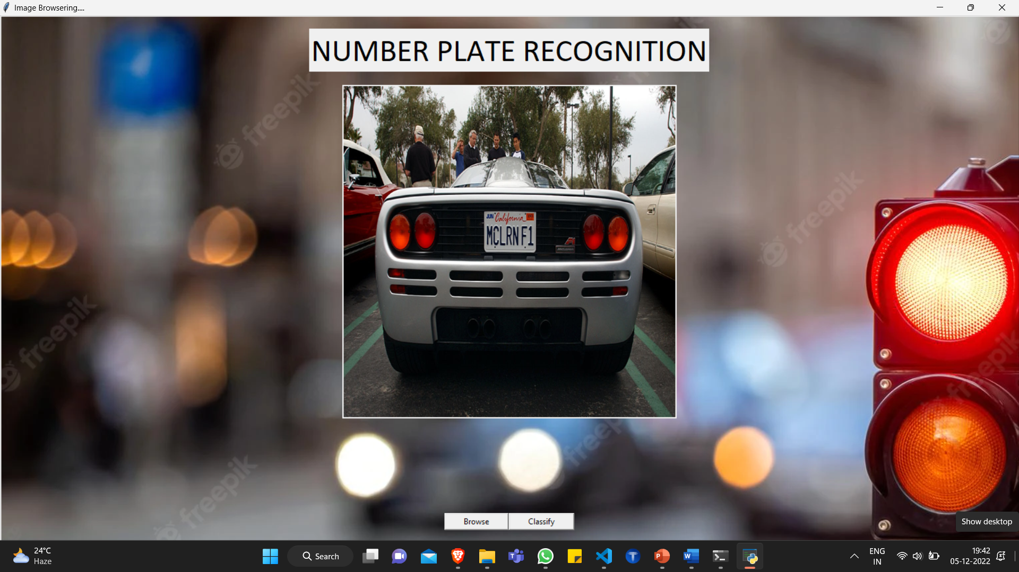
USER INTERFACE

Slide 24

USER INTERFACE

Slide 25
Test Cases

Slide 26
Test Case Id | Test Case Description | Expected Results | Actual Result | Pass/Fail
01 | User Interface Testing | User should able to upload and view the result images on the system | Users are able to interact with UI and also able to upload and view the output images | Pass
02 | An image with proper lights and visibility | MCLRNF1 | MCLRNF1 | Pass
03 | An Image in which the text is displayed brightly. | RIPLS1 | RIPLS1 | Pass
04 | An image with improper edges and lights | NVSBLE | NVSBE | Fail
IT Department

Slide 27
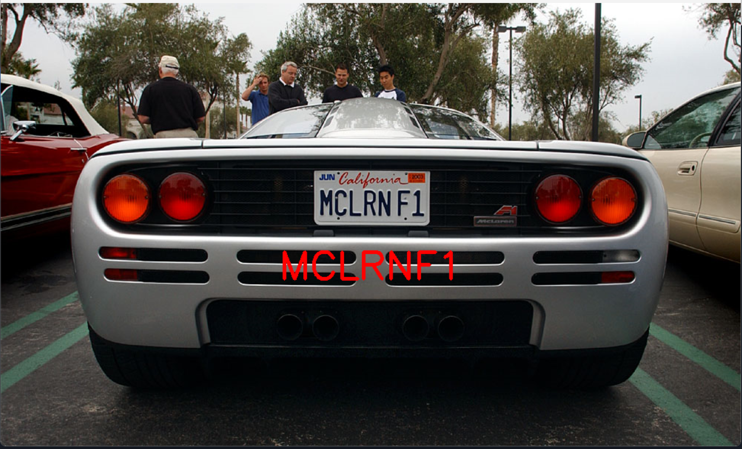
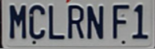

Segmentation/ Detection of Characters

Slide 28
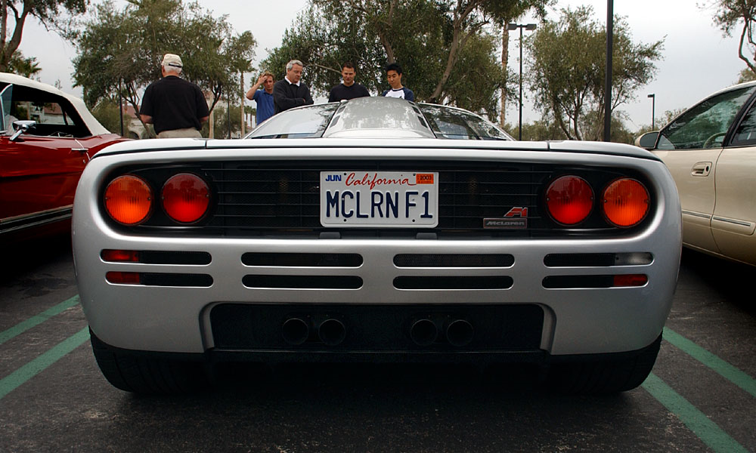
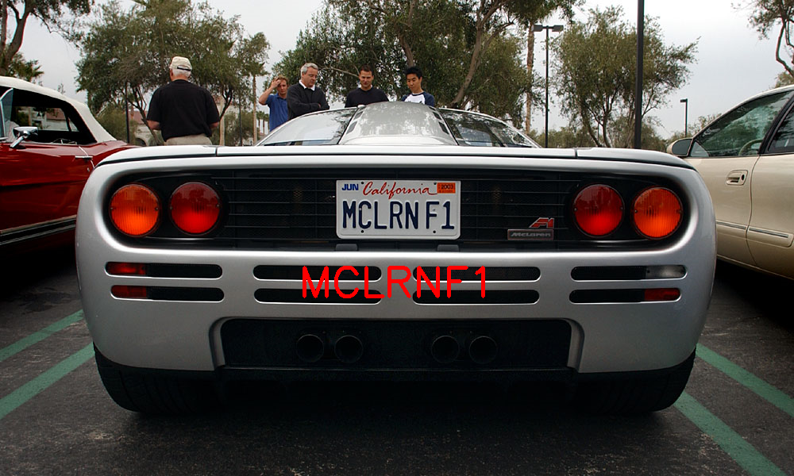
RESULT SCREEN

Slide 29
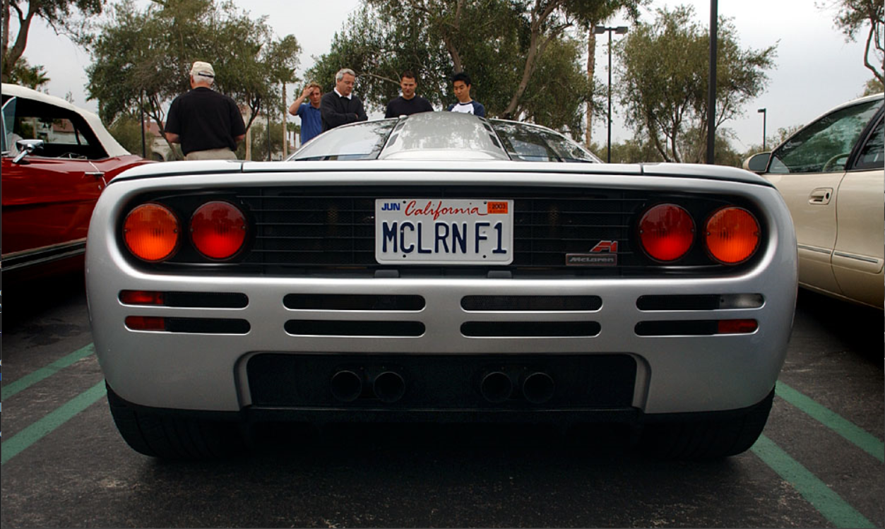
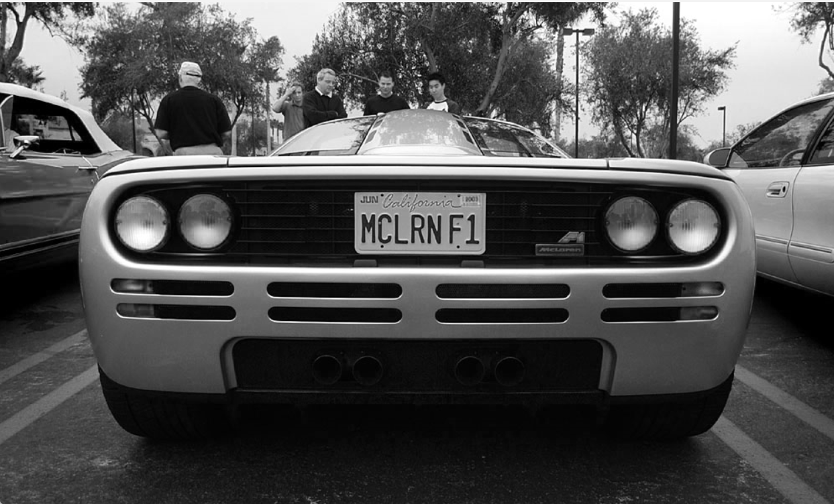
Original Image to GrayScale Image

Slide 30
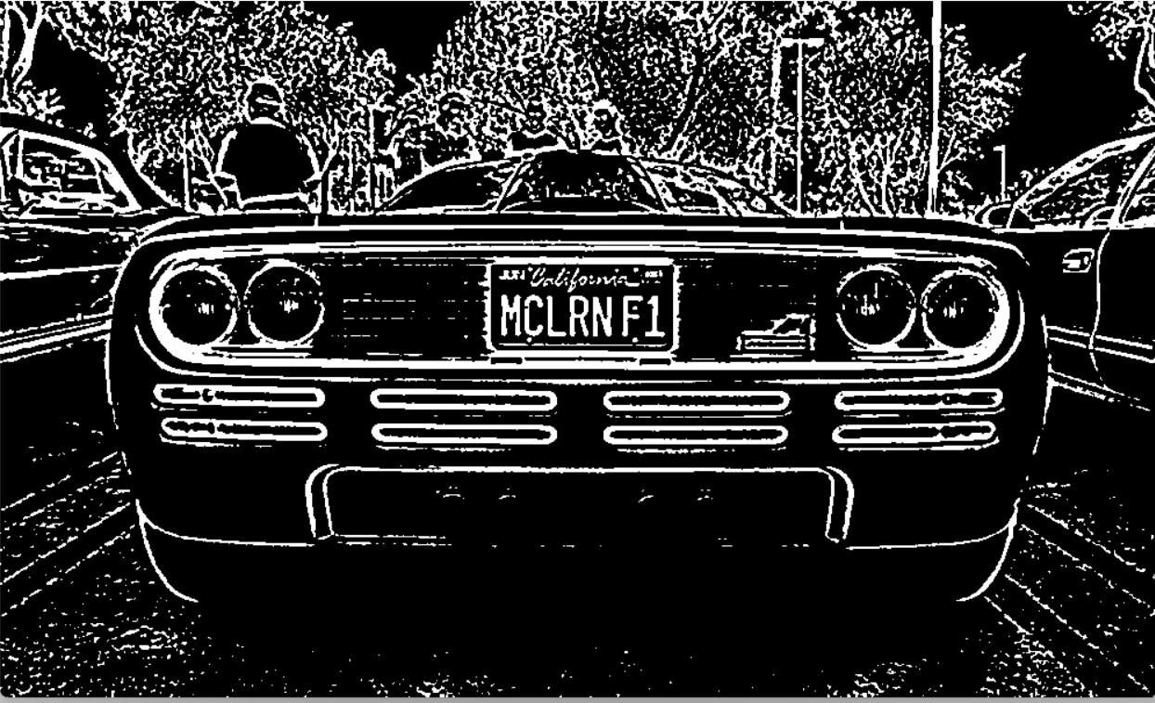
Gray-Scale Image to Edges Detection

Slide 31
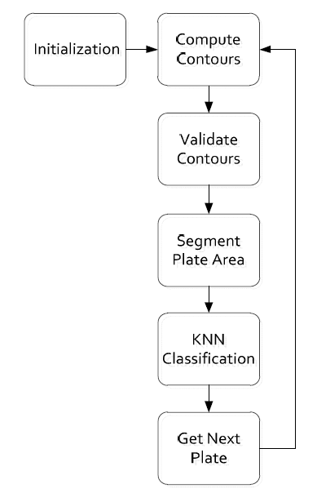
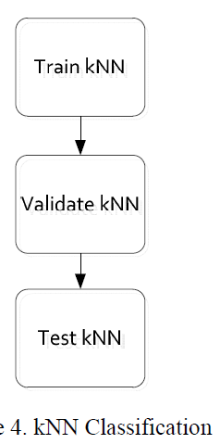
Flow Chart

Slide 32
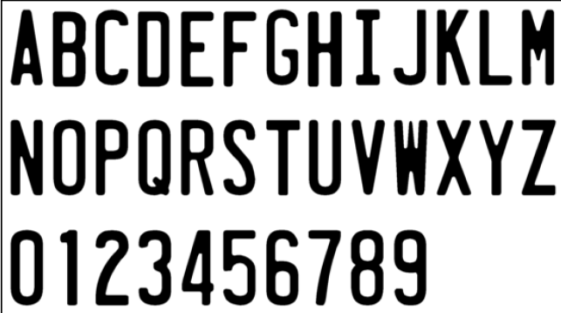
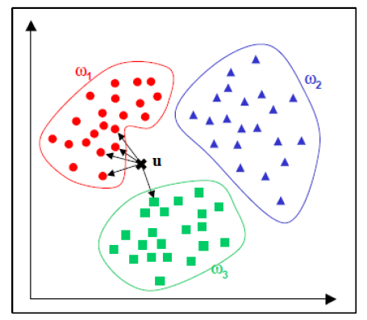
Training Dataset and Process

Slide 33




Few examples of the elements classifications
Mis-classified elements
Classified Elements
IT Department

Slide 34
Conclusions
The automatic vehicle and number plate detection system plays an important role in detecting security threat.
In this project, I aimed to develop a Number Plate Recognition System using KNN. We got images that has no noise from internet for testing purpose. And We also used different styles of text to train the k-NN model for classification.
The image first goes into the few processing techniques such has Gray-scaling and edge detection. After that the images goes into segmentation phase and those segmented characters are sent for text classification. As the k-NN algorithm has been trained it will try to perform text classification on them.

Slide 35
Future Enhancement
The future Enhancements can be:
A hybrid classifier that can combine different classifiers and train it on a wider variety of dataset to increase the accuracy.
A system where it can identify the no-helmet or Triple riders and send the challan direct to there phone.
By positioning the camera to capture the ideal body and using neural networks in two layers, this accuracy can be significantly increased.
As many scholars like to research in this field, they can build much advanced techniques for detection and recognition which may increase the accuracy.

Slide 36
References
Object Recognition Using K-Nearest Neighbor Supported By Eigen Value Generated From the Features of an Image, Dr. R.Muralidharan
“Handwritten Digit Recognition Using K-Nearest Neighbour Classifier”: U Ravi Babu, Dr. Y Venkateswarlu, Aneel Kumar Chintha.
Kulkarni P, Khatri A, Banga P and Shah K 2009 Automatic number plate recognition (anpr) system for indian conditions 2009 19th International Conference Radioelektronika pp 111-114
M. S. Uddin, A. K. Das and M. A. Taleb, "Real-time Area Based Traffic Density Estimation by Image Processing for Traffic Signal Control System: Bangladesh Perspective," in 2nd Int'l Conf. on Electrical Engineering and Information & Communication Technology, Dhaka, 2015.
B. F. Momin and T. M. Mujawar, "Vehicle detection and Attribute based search of vehicles in video surveillance system," in International Conference on Circuit, Power and Computing Technologies, Nagercoil, 2015.
Sai Jahnavi Bachu, B. Tech in K L University, "Character Recognition using KNN Algorithm" International Journal of Science and Research (IJSR),ISSN: 2319-7064,SJIF (2019): 7.583
Islam R, Sharif K F and Biswas S 2015 Automatic vehicle number plate recognition using structured elements 2015 IEEE Conference on Systems, Process and Control (ICSPC) pp 44-48
M. Kumar, M. K. Jindal and R. K. Sharma, "k-nearest neighbour based offline handwritten Gurmukhi character recognition," in ernational Conference on Image Information Processing,Himachal Pradesh, 2011.
A. R. F. Quiros, A. Abad, A. C. P. Uy, A. Bandala, R. A. Bedruz, E. Sybingco and E. P. Dadios, "Automated Traffic Violation Apprehension System Using Genetic Algorithm and Artificial Neural Network," in TENCON 2016 - 2016 IEEE Region 10 Conference, Singapore, 2016.

Slide 37
Thank You ☺

